Slide 1
Active Web Pages

Slide 2
Introduction
An active web page is a page where the browser performs the logic instead of the server.
An active web page can run on an arbitrary computer instead on a server, the program must be written to avoid dependence on particular features of a computer.
For example, when you are scrolling facebook page you got facebook new post automatically.
How it is possible? With the use of JavaScript Ajax it is possible. Without reloading the page we can get an new information, Like facebook.
So with an active page, everything is happening inside your browser without the need to reload the page every time you want new information.

Slide 3
Applet
Applet is a type of active web pages . It is a Java program that runs in a Web browser. An applet can be a fully functional Java application that are designed to be embedded within an HTML page.
To execute an applet, you most likely need a browser plugin. Because the applet is executed by the plugin and your browser.
Example of applet is Browser Games that runs in web pages.
Now a days applets are less in use because with the use of technologies like HTML5 and JavaScript we can create same kind of applications.

Slide 4
Advantages and Disadvantages
Advantage
increase interactivity for users
It can be supported by multiple browsers under multiple platform like windows, linux and Mac Os etc.
Responses are faster in Applet because it runs in client side.
It is more secure.

Slide 5
Disadvantages
Plugin is required in client browsers to run applet
Some browsers failed to load and runs applets (especially mobile browsers like IOS and Android)

Slide 6
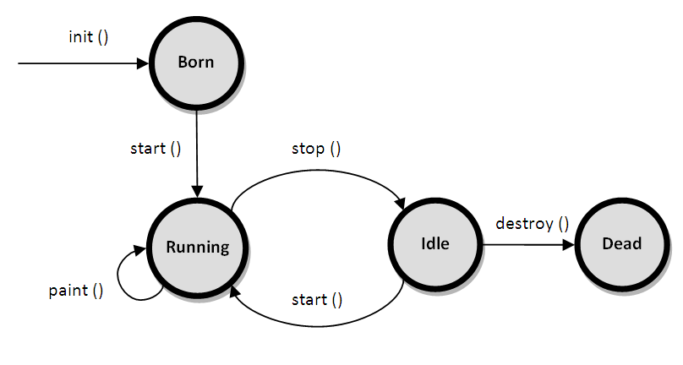
Applet Life Cycle

Slide 7
Life Cycle Described
init(): This method is called at the time of starting the execution. This is called only once in the life cycle. This method initializes the Applet and it helps to initialize variables and instantiate the objects and load the GUI of the applet. This is invoked when the page containing the applet is loaded. It is the born state of a thread.
start(): Even though applet object is created by the init() method, it remains in inactive state. The init() method calls start() method. It starts the execution of Applet. In this state, the applet becomes active .

Slide 8
stop(): In this method the applet becomes temporarily inactive . It is invoked when the Applet stops or when the browser is minimized . The Applet frequently comes to this state in its life cycle and can go back to its active state. It is equivalent to the blocked state of the thread.
paint(): This method Invoked immediately after the start() method, and also any time the applet needs to repaint itself in the browser. The paint() method is actually inherited from the java.awt. This method helps to create Applet’s GUI such as a colored background, drawing and writing. paint() method is called by the start() method. This is called number of times in the execution. This is equivalent to run able state of thread.

Slide 9
destroy(): This destroys the Applet and is also invoked only once when the active browser page containing the applet is closed. It is equivalent to the dead state of the thread.
The init() and destroy() methods are called only once in the life cycle. But, start(), paint() and stop() methods are called a number of times.
Note: What is thread?
A thread is a single sequential flow of control within
a program.

Slide 10
A "Hello, World" Applet
import java.applet.*;
import java.awt.*;
public class HelloWorldApplet extends Applet {
public void paint (Graphics g) {
g.drawString ("Hello World", 25, 50);
}
}
Calling from html
<applet code = " HelloWorldApplet .class" width = "320" height = "120">

Slide 11
Applet Attributes
codebase: This optional attribute specifies the base URL of the applet - the directory or folder that contains the applet's code.
code: This required attribute gives the name of the file that contains the applet's compiled Applet subclass. This file is relative to the base URL of the applet. It cannot be absolute.
width: Used to specify the width of the applet display area.
height: Used to specify the height of the applet display area.
name: Used to specify the name of the applet
align: used to specify the alignment of applet.
hspace: The whitespace on left and right side of an applet, in pixels
vspace: The whitespace on top and bottomside of an applet, in pixels

Slide 12
Note:
Firefox browser version below 52. only support applet
Internet Explorer support it
Click Tools and then Internet Options
Select the Security tab, and select the Custom Level button
Scroll down to Scripting of Java applets
Make sure the Enable radio button is checked
Click OK to save your preference

Slide 13
How to run Applet?
We can run applet two method. One is by running applet linked html file using browser.
By running appletviewer in command line. For Example: if you want to run test.html then type appletviewer test.html then you can see the output in Java Applet Viewer.

Slide 14
java.awt.* imports the Abstract Window Toolkit (AWT) classes. Applets interact with the user (either directly or indirectly) through the AWT. The AWT contains support for a window-based, graphical user interface.
java.applet.* imports the applet package, which contains the class Applet . Every applet that you create must be a subclass of Applet class. The Applet class provides the standard interface between the applet and the browser environment.

Slide 15
Passing Parameters to Applets
<param> tag is used to pass parameter to Applet.
The <param> tag contains two attributes:
name and value which are used to specify the name of the parameter and the value of the parameter respectively.

Slide 16
Example
import java.awt.*;
import java.applet.*;
public class Demo extends Applet {
String msg;
public void init() {
msg=getParameter(“txt");
if(msg==null)
msg=“hello hi";
}
public void paint(Graphics g)
{
g.drawString(msg,10,100);
}
}

Slide 17
<applet code=“Demo.class” height=“500” width=“500”>
<param name=“txt" value="Welcome to applet programming">
</applet>

